Slide 1
Day 7 (MM/DD/YYYY)
D-Code

Slide 2
Welcome!

Slide 3
Standup
Run Your Own Standups
Development Time, Pt. I
Development Time, Pt. II
All-Class Retro

Slide 4
try{whatDoYouRemember();}
Notes:
Review: What is programming? What is the purpose of our working agreement? What does Dev Tools help you do? How do you open an element in Dev Tool?

Slide 5
Topic

Slide 6
Code Hi-Lite
Use for live coding slides
<open>
<open attribute=“file”>
<open>TEXT</close>
</close>
Notes:
Save Changes then See Changes (refresh browser)

Slide 7
Topic
Bullet points

Slide 8
try{assignment();}
Assignment details
Notes:
Save Changes then See Changes (refresh browser)

Slide 9
catch{assignment();}
Assignment details
Note:
Users are only able to select one of the possible options
You can have a preselected radio or checkbox by adding the checked attribute to the input element
Notes:
Save Changes then See Changes (refresh browser)

Slide 10
while(reminders);
Reminder notes
Notes:
Lessons Carried Over:
Have students open the html file in their browser to see their changes

Slide 11
Huddle
List of goals/objectives/topics updated
Topic
Topic
Topic
Topic
Notes:
Any questions?

Slide 12
break;
Write question

Slide 13
continue;
Write answers or summarizations

Slide 14
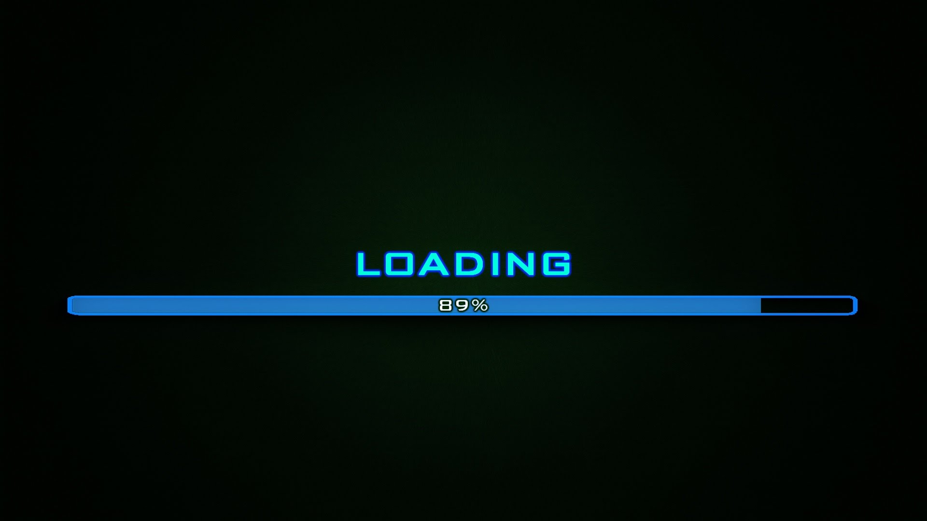
Time Remaining: 5 mins
Notes:
Student break

Slide 15
try{groupOf5([3]);}
Add grouping information
groupOf5[0]=
groupOf5[1]=
groupOf5[2]=
Answer the following questions:
Add questions
Add any individual aspects

Slide 16
Dev Complete
Topic
Topic
Topic
Topic
Testing.. Testing… 123

Slide 17
finally{
talkAboutWhatWe’veLearned();
}
Notes:
Discuss the topics covered:
Topics:
New Processes:
Overall:
-What went well?
-What could have gone better?
-What will do we to improve?

Slide 18
Now We’re Done
Topic
Topic
Topic
Topic
Topic
At least… by our definition of done.

